Slide 1

The Potato Vendor DApp
A Decentralized Token Vending and Locker System

Slide 2
Overview
dApp for ordering potatoes online and delivery through a locker
Privacy Centric: use wallet instead of showing id or person interaction
Customer Centric: no gas fees to buy potatoes or to open a locker

Slide 3
Features
Gas Optimization
The use of ERC20Permit allows buyers to approve token spending off-chain, reducing the number of on-chain transactions
Security
Role-based access control ensures that only authorized accounts can mint tokens or manage purchases
Cryptographic signature verification ensures that only the rightful owner can open lockers
Event-Driven Integration
Events enable seamless integration with backend systems or external applications for notifications, tracking, and analytics

Slide 4
PotatoToken Contract
a ERC20 potato stablecoin
Implements IERC20Permit to provide gasless allowance
Price tied to the price of a potato by the EATER DAO
If potatoes get to cheap, they eat a lot of potatoes from the supply
Otherwise the reverse

Slide 5
PotatoVendor Contract
Permit function calls the IERC20Permit.permit with signature and content and raises an event for the potato-daemon
GetApprovedAmount transfers the potato allowed tokens to itself
ReserveLocker assigns an available locker with the use of randomness and integer overflow
OpenLocker opens the locker if user provides signed message of the locker number

Slide 6
How It Works
BE/FE for buying potatoes on public internet
BE/FE for opening locker on wifi of embedded locker mgmt system
Daemon (TEE) to listen on events
BuyPotato: register email to buyer and reserves locker
LockerAssigned: send order confirmation to buyer with locker number
LockerOpened: send pickup confirmation to buyer

Slide 7
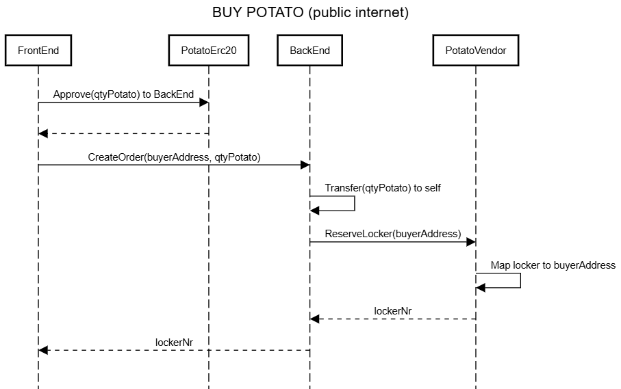
How It Works

Slide 8
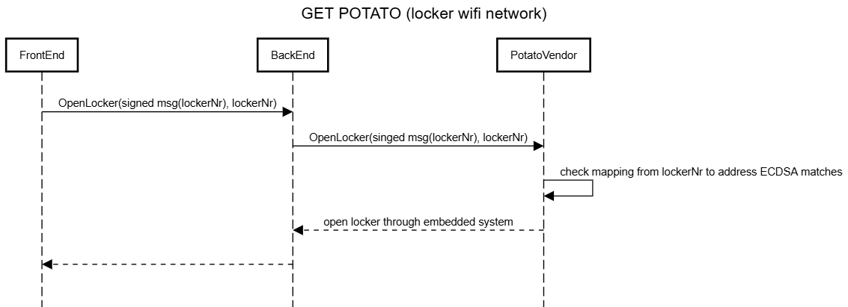
How It Works

Slide 9
Use Cases
Gasless purchases
Locker-Based Delivery
Handling of goods for which privacy is paramount

Slide 10
Improvements
Implementing oracles to tie the price of potatoes with stablecoins

Slide 11
Conclusions
EVM events can be used as Kafka / ServiceBus to a TEE
Use NestJS BE instead of scaffold-eth (time issue)

